Slide 1



Measuring Fairness in Ranked Results: An Analytical and Empirical Comparison
Amifa Raj and Michael D. Ekstrand People and Information Research Team, Boise State University
grant IIS 17-51278

Slide 2




Slide 3

Bias in Ranking
Disparate Exposure

Slide 4
Fair Ranking Metrics Resources
Fairness of Exposure in Rankings
Measuring Fairness in Ranked Output
FA*IR: A Fair Top-k Ranking Algorithm
Yang et. al.
SSDBM’17
PreF𝚫
Zhelike et. al.
CIKM’17
FAIR
Singh and Joachims
KDD’18
D* (DP, EUR, RUR)
Quantifying the Impact of User Attention Fair Group Representation in Ranked List
Equity of Attention: Amortizing Individual Fairness in Rankings
Evaluating Stochastic Rankings with Expected Exposure
Biega et. al.
SIGIR’18
IAA
Sapiezynski et. al.
WWW’19
AWRF
Diaz et. al.
CIKM’20
EE* (EEL, EER, EED)

Slide 5



Why the Problem is a Problem!
Finding Suitable Metrics
Differences among the Metrics
Several Fair Ranking Metrics

Slide 6
Contributions
Identify gaps between their original presentation and the practicalities of applying them to IR systems
Describe and compare rank-fairness metrics in unified framework
Direct comparison of their outcomes with the same data and experimental setting
Sensitivity analysis to assess the impact of design
choices and external factors on these metrics

Slide 7



Fairness Positioning
Group Fairness
Provider Fairness
Consumer Provider Group Individual

Slide 8
Factors We Considered
System-
Target Comparison
Ratio-based
Distance function
Group Membership
Soft Association
Multinomial Distribution
Fairness Goal
Relevance
Weighting Strategy

Slide 9
Fairness Definition
PreF𝚫, FAIR, AWRF, DP, EED
IAA, EUR, RUR, EEL, EER
Item position should not be affected by membership
Exposure/attention should be proportional to relevance
Equal Opportunity
Statistical
Parity

Slide 10








Low order
Ranked List
Protected Group
Non-Protected Group

Slide 11


Statistical Parity (Single Ranking)
Attention/Exposure
AWRF (Sapienzynski et. al)
no relevance information
geometric attention decay
non-binary group membership
uses a target distribution to compare
⋀
Expected cumulative exposure( x position weight) >=p
Target distribution is the group distribution in entire ranked list (true demographics)
PreF𝚫 (Yang et. al) and FAIR (Zehlike et. al) do not use position weight

Slide 12
Sequence of Ranking
.
.
.

Slide 13
Statistical Parity (Multiple Ranking)
Demographic Parity (Singh et.al)
Exp =Exp
logarithmic attention decay
binary group membership
Expected-Exposure Disparity (Diaz et.al)
EED: Demographic Parity
rbp & cascade attention decay
non-binary group membership

Slide 14
Equal Opportunity
relevance
exposure
.
.
.
Exposure should be proportional to relevance

Slide 15
Equal Opportunity
stochastic ranking
rbp & cascade attention decay
non-binary group membership
EE* (Diaz et. al)
EEL(Expected Exposure Loss): ||target-system||2
EER (Expected Exposure Relevance): Exposure-relevance distribution
IAA (Biega et. al) differs in weighting strategy, group membership, and relevance
EUR, RUR (Singh et. al) differs in weighting strategy and group membership

Slide 16
Browsing Model (Weighting Strategy)
visiting probability exponentially decreases with position
RBP
visiting probability exponentially decreases with position
Geometric
patience parameter
stopping probability
visiting probability depends on relevance of visited items
Cascade
visiting probability logarithmically decreases with position
Logarithmic
patience parameter
stopping probability
16

Slide 17
Summary of Fair Ranking Metrics
Metric(s) | Goal | Weighting | Relevance | Binomial?
PreFd | Each prefix representative of whole ranking | ❌ | ❌ | Dep on d
FAIR | Each prefix matches target distribution | ❌ | ❌ | ✓
AWRF | Weighted representation matches population | Geometric | ❌ | ❌
DP | Exposure equal across groups | Logarithmic | ❌ | ✓
DTR | Exposure proportional to relevance | Logarithmic | ✓ | ✓
DIR | Discounted gain proportional to relevance | Logarithmic | ✓ | ✓
IAA | Exposure proportional to predicted relevance | Geometric | Predicted | ❌
EEL, EER | Exposure matches ideal (from relevance) | Cascade, Geom | ✓ | ❌
EED | Exposure well-distributed | Cascade, Geom | ❌ | ❌

Slide 18
Implementing the Metrics
 | Recommendations | Search (retrieval and re-ranking)
Dataset | GoodReads bookdata | FairTREC 2020
Sensitive Attributes | Gender of author | Economic development of the author’s country of scholarly articles
Algorithms | CF (implicit feedback) | Participants provided

Slide 19





Challenges in Implementation
IAA, EE*, DP, EUR, RUR
AWRF, IAA, DP, EUR, RUR, EE*
Missing Relevance Information
All the metrics
Parameter Setting
Missing Group Label
PreF𝚫, FAIR, IAA, DP, EUR, RUR
PreF𝚫 and RUR: suffer from missing data (sparsity) problem
Reformulated ratio-based metric to smoothed log ratio
Soft Group Association
Non-binary groups
Extreme Imbalance

Slide 20
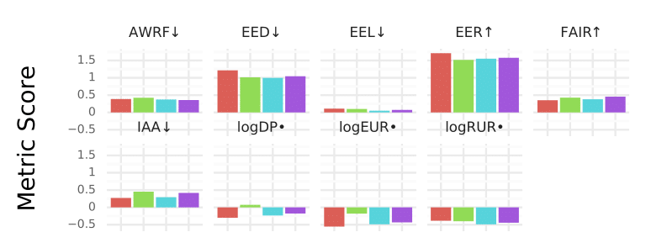
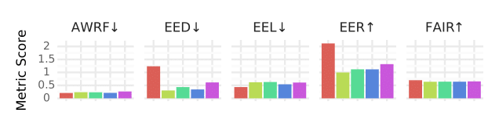
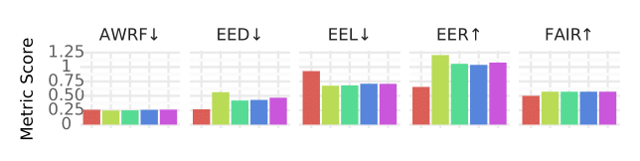
Direct Comparison
Metrics frequently disagree on system orderings.
No clear agreement.
The most consistently-agreeing pair is FAIR and AWRF∆
GoodReads
FairTRECretrieval
FairTREC reranking

Slide 21
Sensitivity Analysis
Ranked-list size
Weighting
Strategy
Stopping Probability
Patience Parameter
No effect on metrics for FairTREC
Ratio-based metrics and FAIR showed sensitivity
Default parameters
EEL and logRUR showed high sensitivity
Almost all metrics showed sensitivity
logRUR is extremely sensitive
logRUR showed high sensitivity

Slide 22
Key Findings
Defining metrics in unified framework
Metrics are surprisingly similar
Missing data, missing relevance information, ranked list size are crucial/delicate factors in implementing metrics.
Implement the metrics in same experimental setup
Sensitivity Analysis
Metrics differ in their sensitivity towards external factors.
High sensitivity towards design choices add complexity in the usability of metrics

Slide 23
Recommendations
Allow multinomial protected attributes | Allow soft group association | Sensitivity towards design choices
AWRF | AWRF | AWRF
EED | EED | EED
EER, EEL | EER, EEL | EER, EEL, IAA
Single-list metrics
FAIR, AWRF
Demographic Parity in Sequence
DP, EED
Equal Opportunity in Sequence
EUR, RUR, IAA, EER, EEL

Slide 24
Future Work
Conclusion
Missing label
Missing or sparse relevance
Ambiguous or multiple group association
Robust, explainable, and efficient metric design
Simulation study to understand the impact of crucial factors in metric implementation.

Slide 25
THANK You!

